Slide 1
Data Cleaning
DSPG

Slide 2


Data Cleaning
Data cleaning refers to the process of either fixing or removing data in a data source that is incorrect, incomplete, improperly formatted, or duplicated.
Notes:
https://towardsdatascience.com/data-cleaning-with-r-and-the-tidyverse-detecting-missing-values-ea23c519bc62

Slide 3
Reading in Data
data1 <- read.csv(“file path”)
“pigpen1.csv”

Slide 4
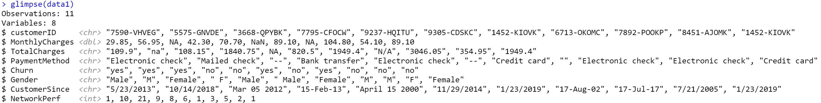
glimpse()
A Tidyverse function that provides a listing of variable names and types

Slide 5
Duplicate Rows/Cases
There appears to be duplicate rows in our data set.

Slide 6
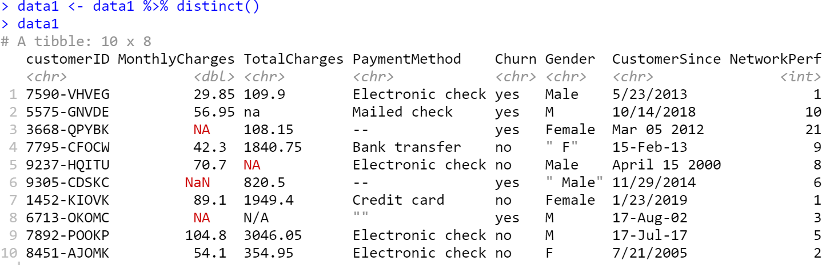
Duplicate Rows/Cases
Removing duplicate rows/cases.
To save:
data1 <- *code*

Slide 7
Missing Values
Let’s look at the Monthly Charges variable.

Slide 8
Missing Values
Let’s look at the Monthly Charges variable.
‘$’ symbol specifies a certain column in Tibble by returning a vector of values
Notes:
We can see that the two missing cells were recognized as “NA” and the other missing value with Nan was identified by R as “NaN”.
When we run the is.na function, R recognizes both types of missing values. We can see this because there’s three TRUE values that are returned when we run is.na.

Slide 9
Missing Values
Missing/special value types
NA: Stands for not available. NA is a placeholder for a missing value. All basic operations in R handle NA without crashing and mostly return NA as an answer whenever one of the input arguments is NA. [use is.na to detect]
Null: Similar to the empty set from mathematics. NULL is special since it has no class (its class is NULL) and has length 0 so it does not take up any space in a vector. [use is.null to detect]
±Inf: Stands for infinity and only applies to vectors of class numeric. A vector of class integer can never be Inf.
NaN: Stands for not a number. This is generally the result of a calculation of which the result is unknown, but it is surely not a number. In particular operations like 0/0, Inf-Inf and Inf/Inf result in NaN. Computations involving numbers and NaN always result in NaN. [use is.nan to detect]
Notes:
Why missingness is important (obviously)
Missingness mechanisms (MAR, MCAR, MNAR)
Basic and MOSTLY WRONG ways to deal with missingness (mean imputation, median imputation, listwise deletion)
Advanced ways to deal with missingness (multiple imputation, full information maximum likelihood)

Slide 10
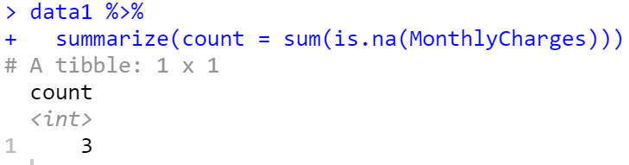
Missing Values
Let’s count the number of missing values for Monthly Charges variable.
Notes:
Count of is.na picks up NA and NaN

Slide 11
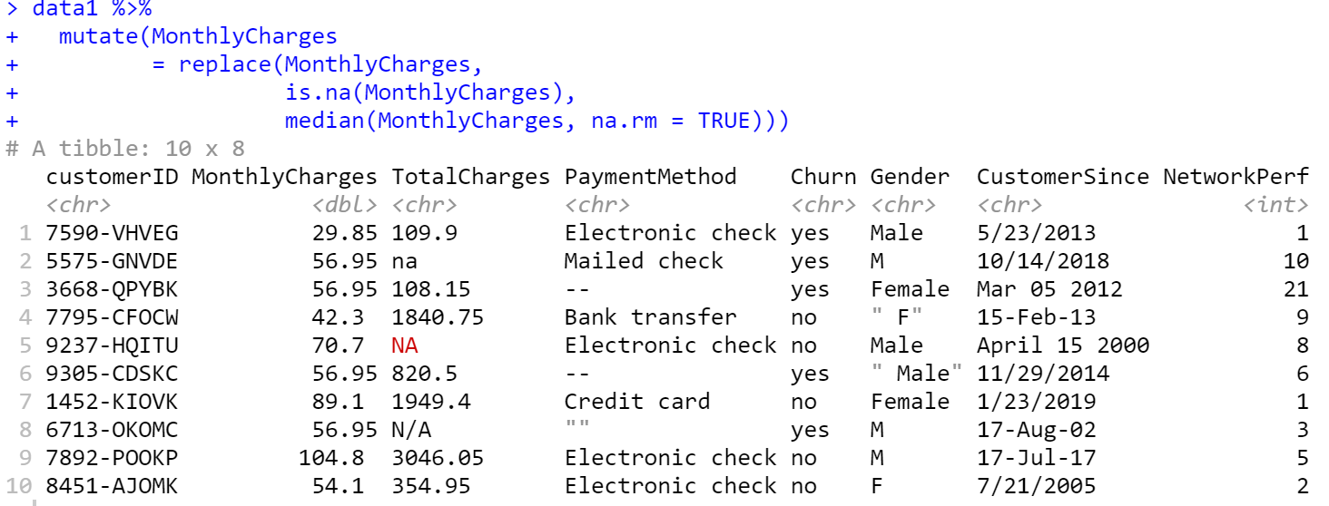
Missing Values
Identify and replace missing values in Monthly Charges variable with the median value
Mutate does not save data, only displays it
To save:
data1 <- *code*
Notes:
Median = 56.95, mutate creates new variable but does not save it

Slide 12
Missing Values
Let’s look at the Total Charges variable.
Notes:
Sometimes missing data is not standardized

Slide 13
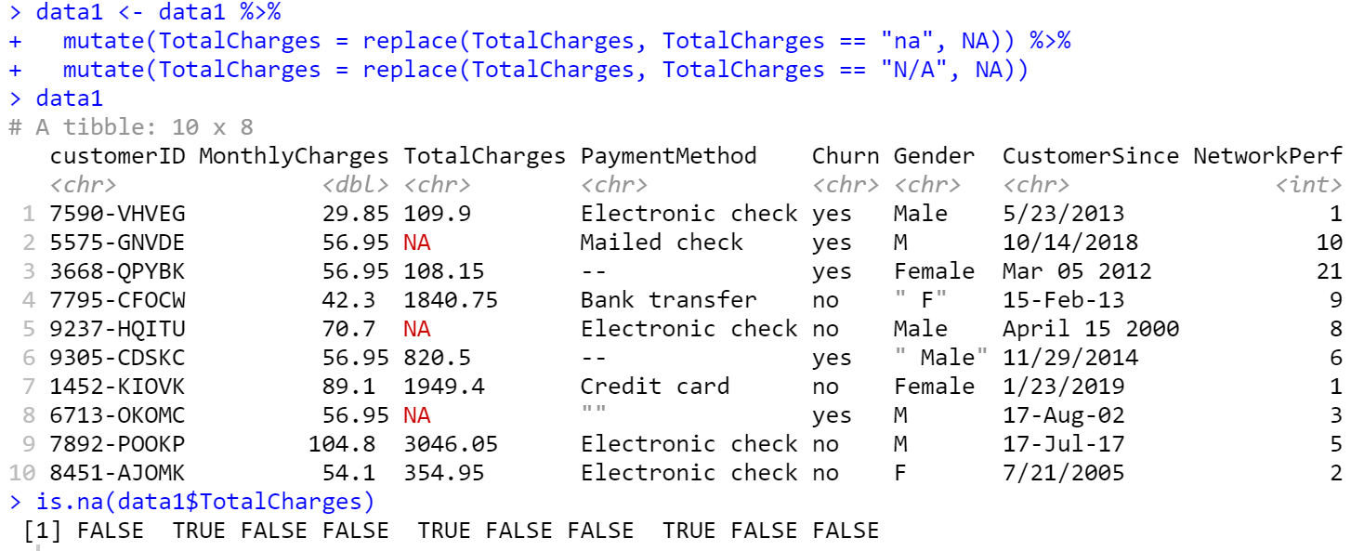
Missing Values
Let’s look at the Total Charges variable.

Slide 14


Changing Variable Type
Total Charges variable looks to be a character type, should be numeric before imputing missing data.

Slide 15
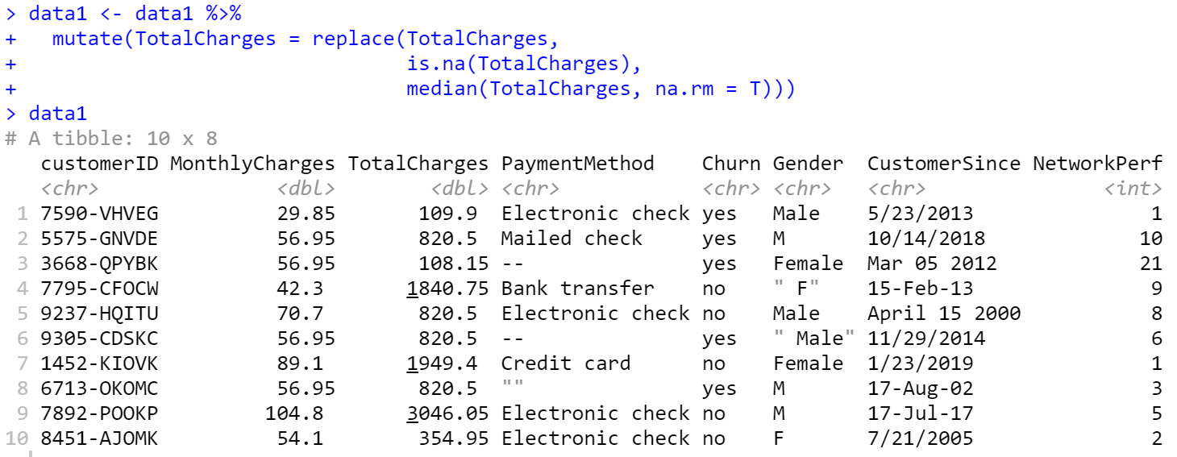
Missing Data
Total Charges variable looks to be a character type, should be numeric before imputing missing data.
Notes:
Median = 820.50

Slide 16
Missing Values
Let’s look at the Payment Method variable.
Notes:
Sometimes missing data is not standardized

Slide 17
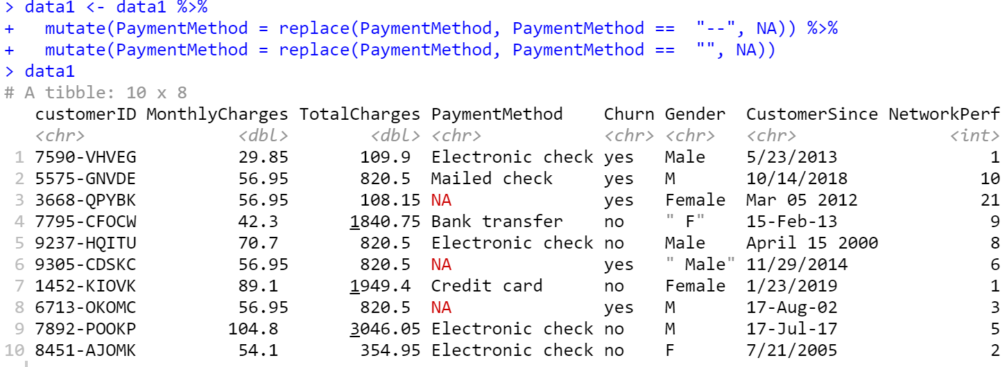
Missing Values
Let’s look at the Payment Method variable.
Notes:
Sometimes missing data is not standardized

Slide 18
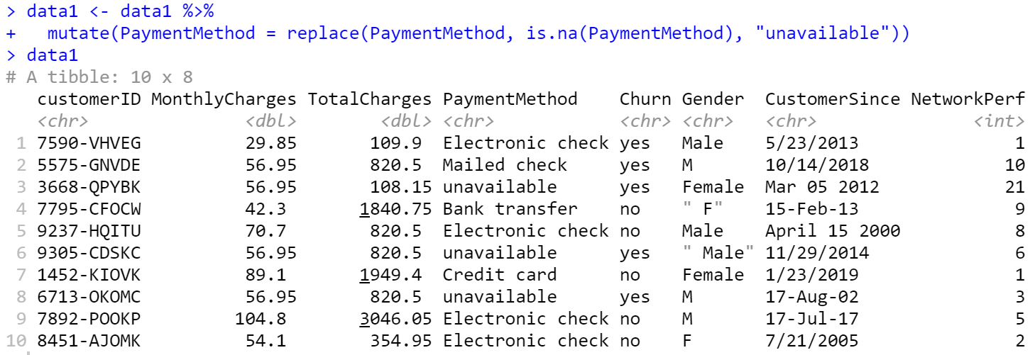
Missing Values
Since Payment Method is a character variable, we cannot impute a median but can replace NAs with a string value.
Notes:
Sometimes missing data is not standardized

Slide 19
Removing Extra Spaces
There are extra spaces in the Gender variable
Notes:
Sometimes missing data is not standardized

Slide 20
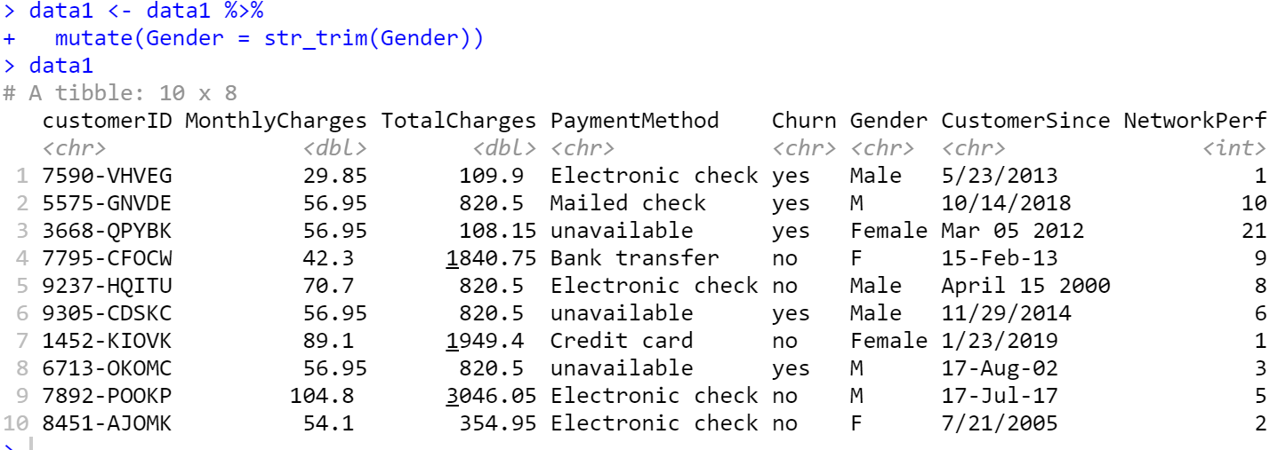
Removing Extra Spaces
Use the str_trim() function from the stringr package which removes extra white space before and after a string data entry
Notes:
Sometimes missing data is not standardized

Slide 21
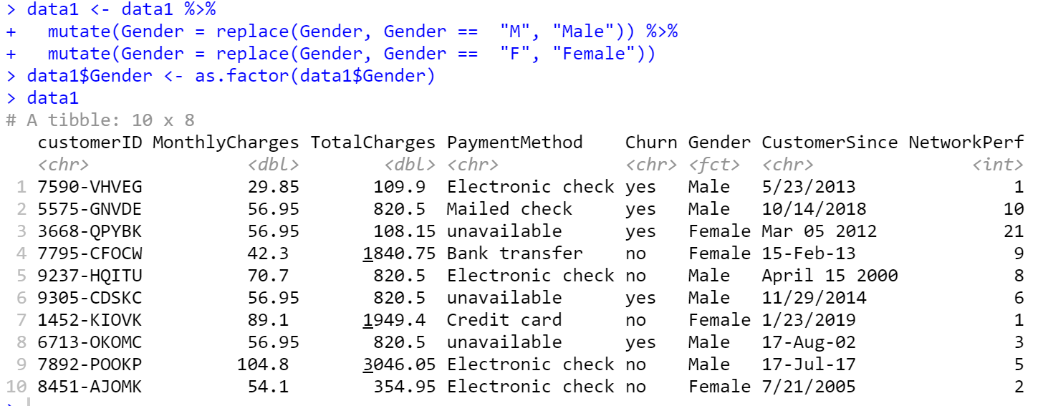
Recoding Values
Need to standardize coding of Gender values and treat it as a factor.
Notes:
Sometimes missing data is not standardized

Slide 22
Standardized Time/Date
Need to standardize coding of Customer Since date values into Year-Month-Day.
Desired Format: Year-Month-Day (e.g., 2019-06-24)
Notes:
Sometimes missing data is not standardized

Slide 23
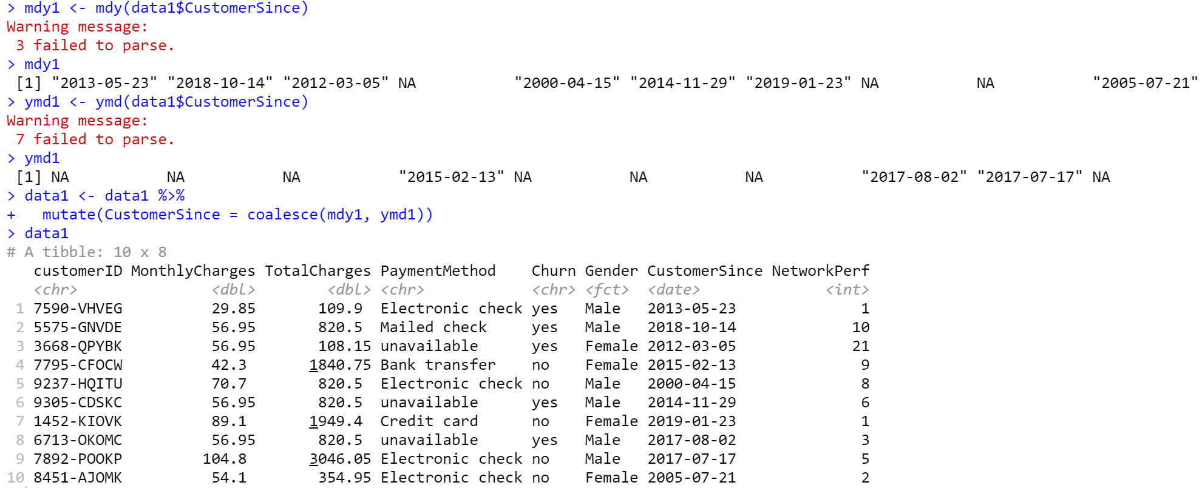
Standardized Time/Date
Need to standardize coding of Customer Since date values into Year-Month-Day.
A date is a day stored as
the number of days since
1970-01-01
as.numeric(as_date("2017-07-17"))
## 17364
Notes:
Sometimes missing data is not standardized

Slide 24
Outlier/Input Error Detection
Use the summary()function to look for outliers.
Notes:
If we used a 1-10 scale then anything outside of that would be an error or outlier

Slide 25
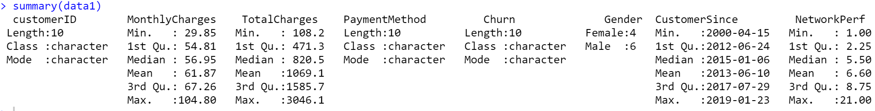
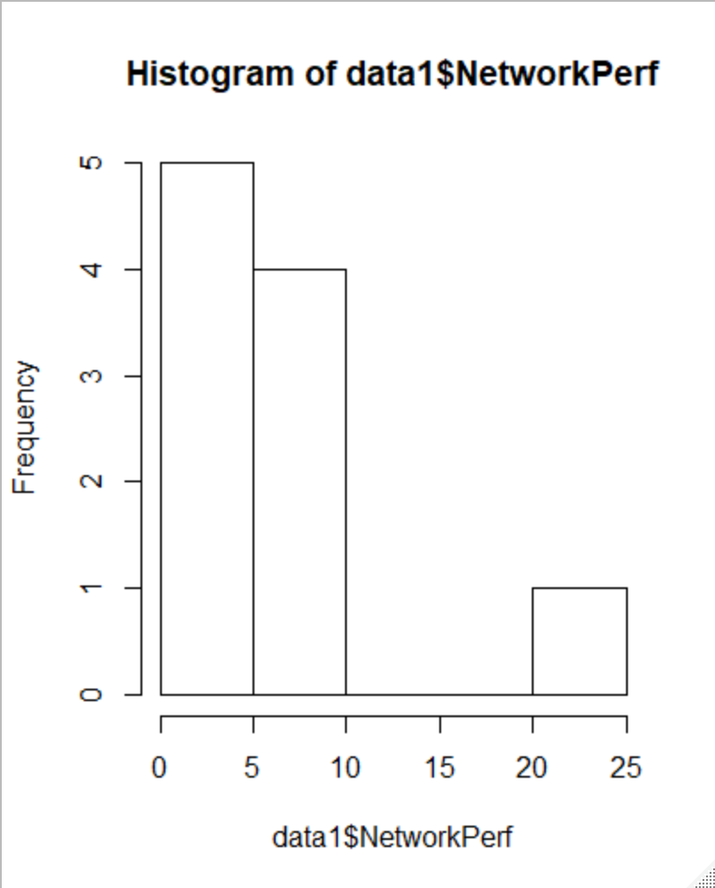
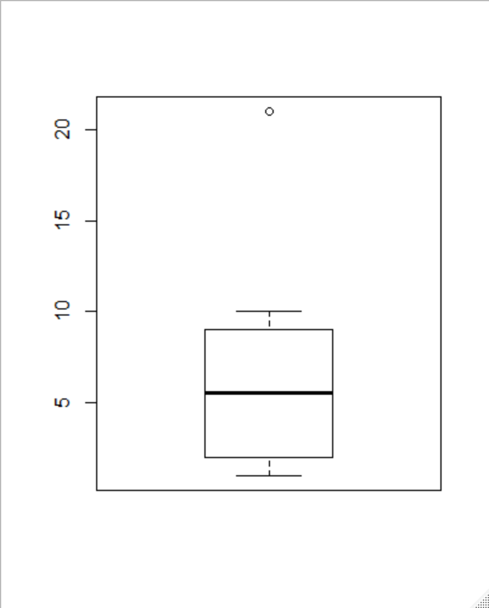
Outlier/Input Error Detection
Use the summary()function to look for outliers.
> hist(data1$NetworkPerf)
> boxplot(data1$NetworkPerf)
Notes:
Sometimes missing data is not standardized

Slide 26
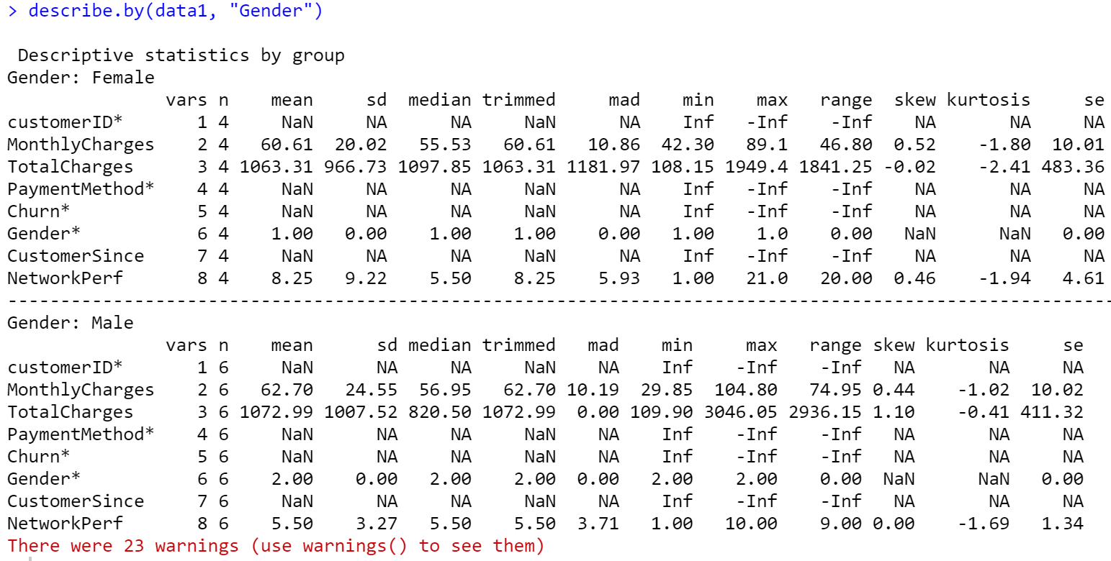
Outlier/Input Error Detection
Use the describe()function to look for outliers.
library(psych)
describe(data1)
describe.by(data1, "Gender"))
Notes:
Sometimes missing data is not standardized

Slide 27
Back Up Slides

Slide 28
Variable Types
Numeric - Numeric data (approximations of the real numbers; e.g., 1, 0.6667)
Integer - Integer data (whole numbers; e.g., 2, 5)
Factor - Categorical data (simple classifications; male, female)
Ordered - Ordinal data (ordered classifications; e.g., high school, some college, college)
Character - Character data (strings; e.g., “this experiment seems fake”)
Raw - Binary data
See type using class(x)
or, for all columns of a data frame using sapply(DF, class)

Slide 29
Coercing Variable Types
Converting a variable from one type to another is called coercion. The reader is probably familiar with R's basic coercion functions, but as a reference they are listed here. By default, values that cannot be converted to the specified type will be converted to a ‘NA’ value while a warning is issued.
as.numeric
as.integer
as.factor
as.ordered
as.character
as.logical

Slide 30
Indexing Types
How data is stored:
Vectors – a sequence of data elements of the same basic type
Lists – a generic vector containing other objects
Matrices – a collection of data elements arranged in a two-dimensional rectangular layout
Data Frames – a list of vectors of equal length used for data tables with headers
Tibbles – special types of data frames with enhanced printing behavior

